Slide 1



Foundation of AI
College Club Event Recommendation & Timetable Plannerr
BY
Bharath.J
Akash.M

Slide 2

Abstract
The College Club Event Recommendation & Timetable Planner is a rule-based system that helps students find suitable college club events based on their interests, eligibility, and availability.
The system uses deterministic rules, search techniques, and constraint satisfaction to recommend events and generate a conflict-free timetable.
Unlike machine-learning systems, the proposed system does not use Machine Learning. The recommendations are generated using predefined rules and logical reasoning.

Slide 3
Problem Statement
The College Club Event Recommendation & Timetable Planner is a rule-based system that helps students find suitable college club events based on their interests, eligibility, and availability.
The system uses deterministic rules, search techniques, and constraint satisfaction to recommend events and generate a conflict-free timetable.
Unlike machine-learning systems, the proposed system does not use Machine Learning. The recommendations are generated using predefined rules and logical reasoning.

Slide 4
Literature Survey
You can keep this slide similar to your friend's Literature Survey slide.
Existing approaches generally focus on:
Basic event listing and registration
Manual selection of college activities
Separate timetable management
Simple event filtering
Limitations:
Limited personalized recommendation
No integrated timetable planning
Manual conflict detection
No rule-based reasoning for event selection

Slide 5
Research Gap
Existing systems have limited support for combining:
Student interest-based event recommendation
Eligibility checking
Availability checking
Timetable generation
Conflict detection
Automatic conflict resolution
Therefore, there is a need for a single deterministic AI-based system that combines recommendation and timetable planning.

Slide 6
Reasearch objective
The main objectives are:
To recommend suitable college club events based on student preferences.
To check student eligibility for events.
To consider student availability while selecting events.
To detect overlapping event timings.
To use CSP and Backtracking for timetable planning.
To provide a conflict-free timetable using deterministic rules.

Slide 7
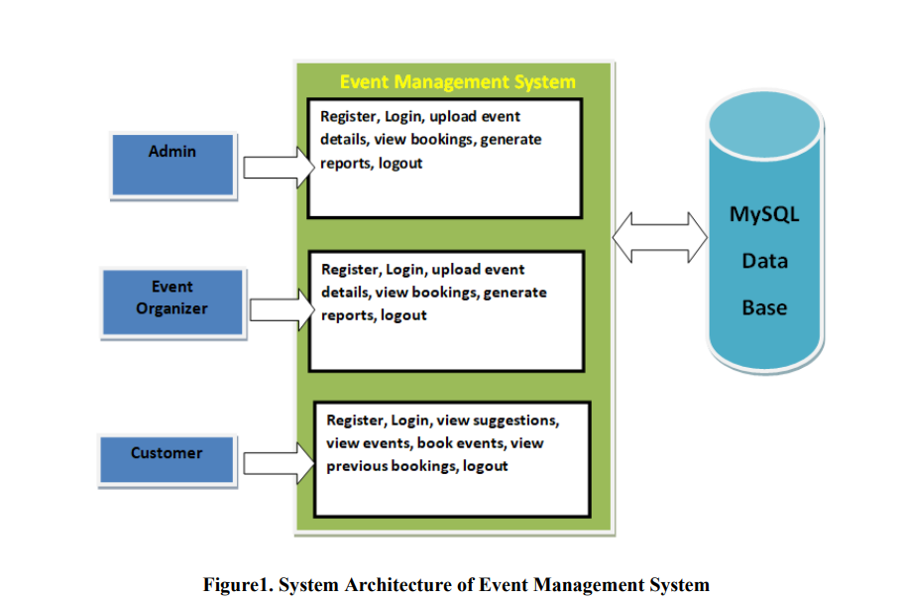
Architecture Diagram

Slide 8
Tech Stack
Frontend
HTML
CSS
JavaScript
Backend
Python
Flask
Database
SQLite
AI Module
Python Rule Engine
A* Search
CSP
Backtracking
Development Tools
VS Code
GitHub

Slide 9
Algorithm
1. Start
2. Get student preferences
3. Get available club events
4. Apply eligibility rules
5. Apply interest-based rules
6. Check student availability
7. Generate possible event schedules

Slide 10
Output
Recommended Events
Event | Club | Time | Status
AI Workshop | AI Club | 10–11 AM | Recommended
Coding Contest | Coding Club | 11–12 PM | Recommended
Football | Sports Club | 2–3 PM | Recommended

Slide 11
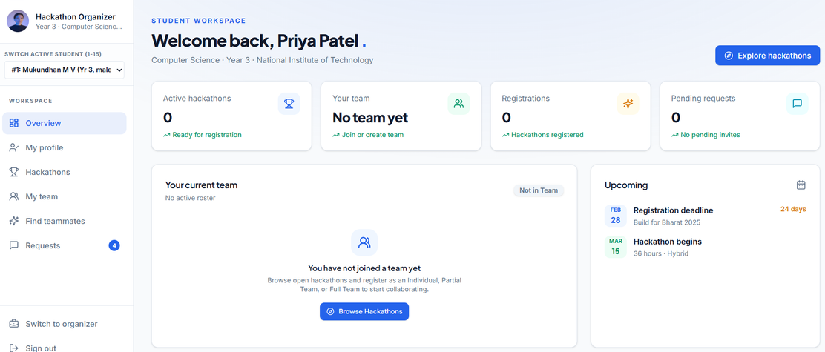
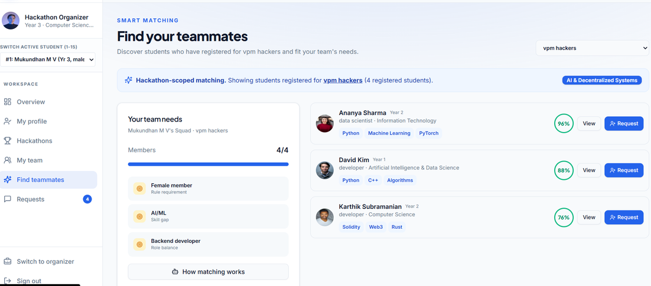
Output
Students

Slide 12
Thank You

